Slide 1
Automatic Translations
for Skillshare
June 2020
Notes:
20 s

Slide 2
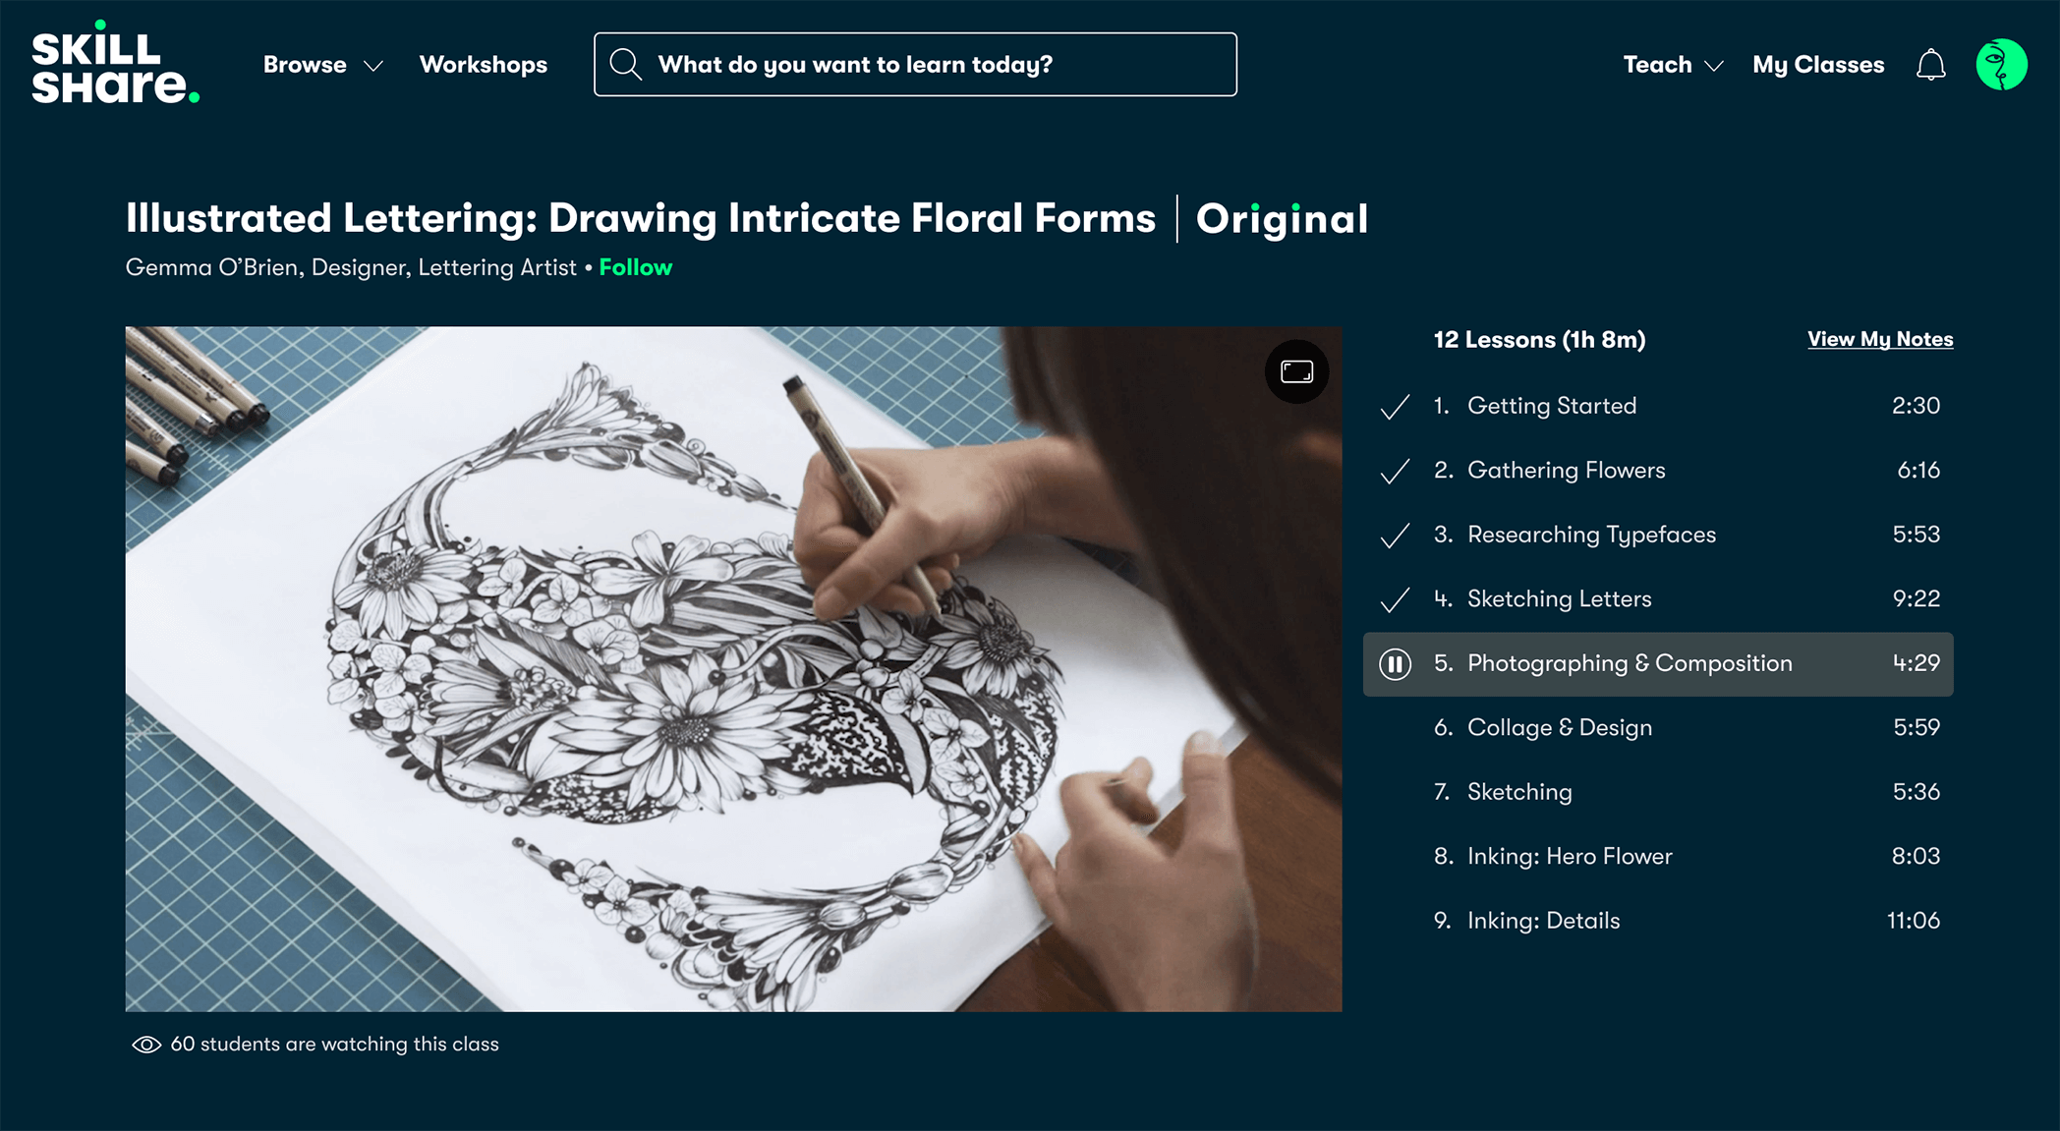
Skillshare needs
To go beyond English spoken users.
Online translations for transcriptions.
1
1
Automatic process without affecting user experience.
Videos and transcription are in English.
2
2
Notes:
15

Slide 3


Notes:
70 s

Slide 4




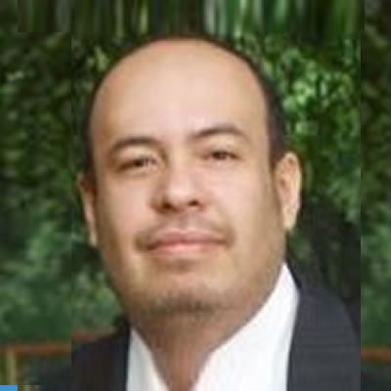
Zombieland CLI Team (Cali, cohort 10)
Team and roles
FrontEnd and Design
HTML, CSS, Javascript, AWS CloudFront,
AWS S3
Carlos A. García M., SWE
@karlgarmor agzsoftsi
BackEnd
Python, AWS Lambda, AWS API Gateway, AWS S3,
AWS Translate
Leonardo Calderon J., SWE
@leocj leocjj
FrontEnd and Testing HTML, CSS, Javascript, AWS CloudFront,
AWS S3
Ivan D. Lasso G., SWE
@ilasso ilasso
Notes:
10

Slide 5
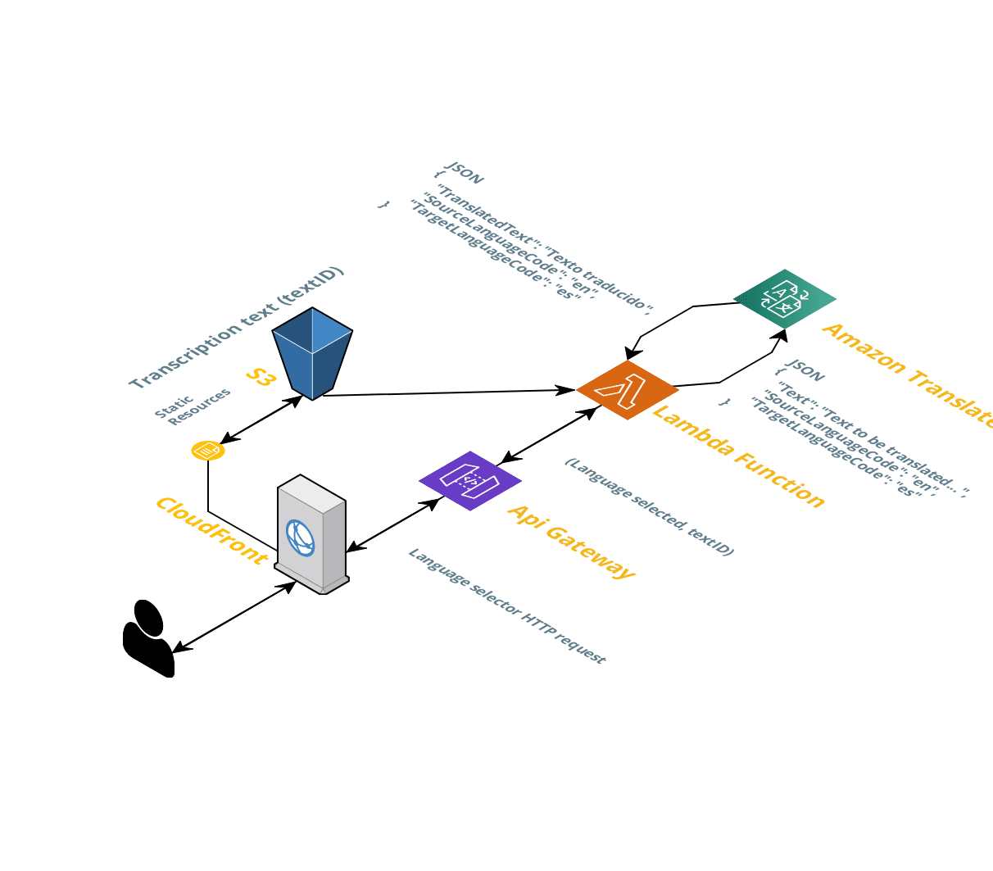
Technologies & Architecture
AWS - Amazon Web Services:
API Gateway
Lambda function (Python)
S3 objects
Translate
Comprehend
Notes:
15

Slide 6
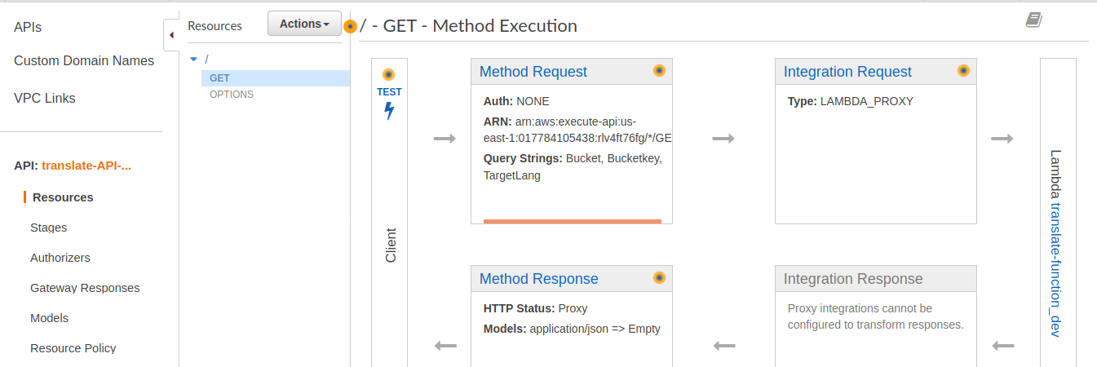
Core algorithms/code snippet
Notes:
15

Slide 7
lambda_function.py
def translateBatches(sourceLang, targetLang, text):
''' Translate text in batches of step size '''
lenn = len(text)
if lenn <= step:
try:
translatedText = translateClient.translate_text( Text = text,
SourceLanguageCode = sourceLang,
TargetLanguageCode = targetLang
)
except translateClient.exceptions.ClientError as e:
if e.response['Error']['Code'] == "500":
resp['statusCode'] = 500 # Internal error
return None
return translatedText.get('TranslatedText')
Notes:
15

Slide 8
Collaboration rules
Scrum based
Timeline (6 weeks)
PROJECT
One external daily with the Client
Two internal daily:
To share individual research
To do pair programming
Team approval for each new code.
The Sprint: weekly, Friday to Thursday
Sprint Planning: each Friday
Daily Scrum Mo-Th, 11 am.
Sprint Review: each Thursday
Sprint Retrospective: each Friday
May 15
May 22
May 29
June 5
June 12
June 19
Proposal
MVP definition
Project plan
Status report 1/3
Status report 2/3
Final status report
.
.
.
.
.
.
Notes:
30

Slide 9
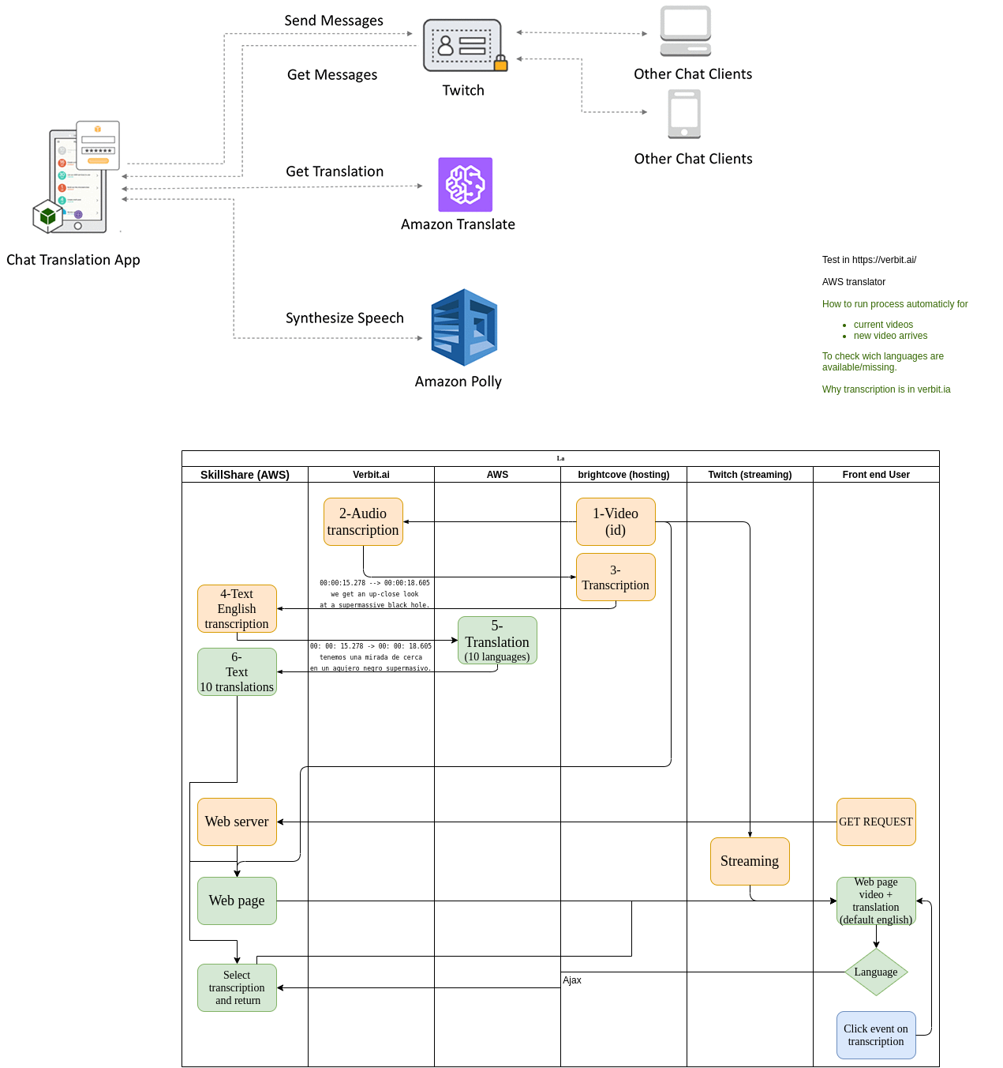
Main challenge overcome
Initial architecture definition
Technical details were not available from the beginning.
Notes:
30

Slide 10




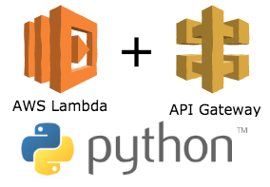
Learning lessons
01 | To define architecture with an extended team.
02 | Scrum helps to organize, prioritize, and develop.
03 | Well defined team rules help during the journey.
04 | To use the right technology rather than use “the best”.
05 | We are capable to learn what we need.
Notes:
15

Slide 11
Live demo
Landing page:
https://transcriptions-translations.s3.amazonaws.com/landing/index.html
MVP:
https://transcriptions-translations.s3.amazonaws.com/index.html
API test:
https://ytuln8zsz1.execute-api.us-east-1.amazonaws.com/translatetext?TargetLang=es&Bucketkey=formats/video1t.srt

Slide 12
Thank you
Holberton School Silvia Guzmán, Johanna Alzate, Laura C. Sánchez Andrés Barreto, Andrés Rojas Cohort 10 Cali peers
We made it, keep moving!!!

